Slide 1


Slide 2


Lecture 2.
Audio representation: Spectrograms
Yermekova Assel
Skoltech ‘22
MLE in Noah Ark Lab, Huawei
Domain expansion

Slide 3
Content
Lecture: Spectrograms

Slide 4
Content:
problems in using waveforms
Frequency spectrum
Fourier Series
Fourier Transform
Discrete Fourier Transform
Spectrograms and STFT
Mel-Scale
Mel filter bank
Mel-Spectrogram
Lecture summary

Slide 5
Why not use only waveforms?

Slide 6

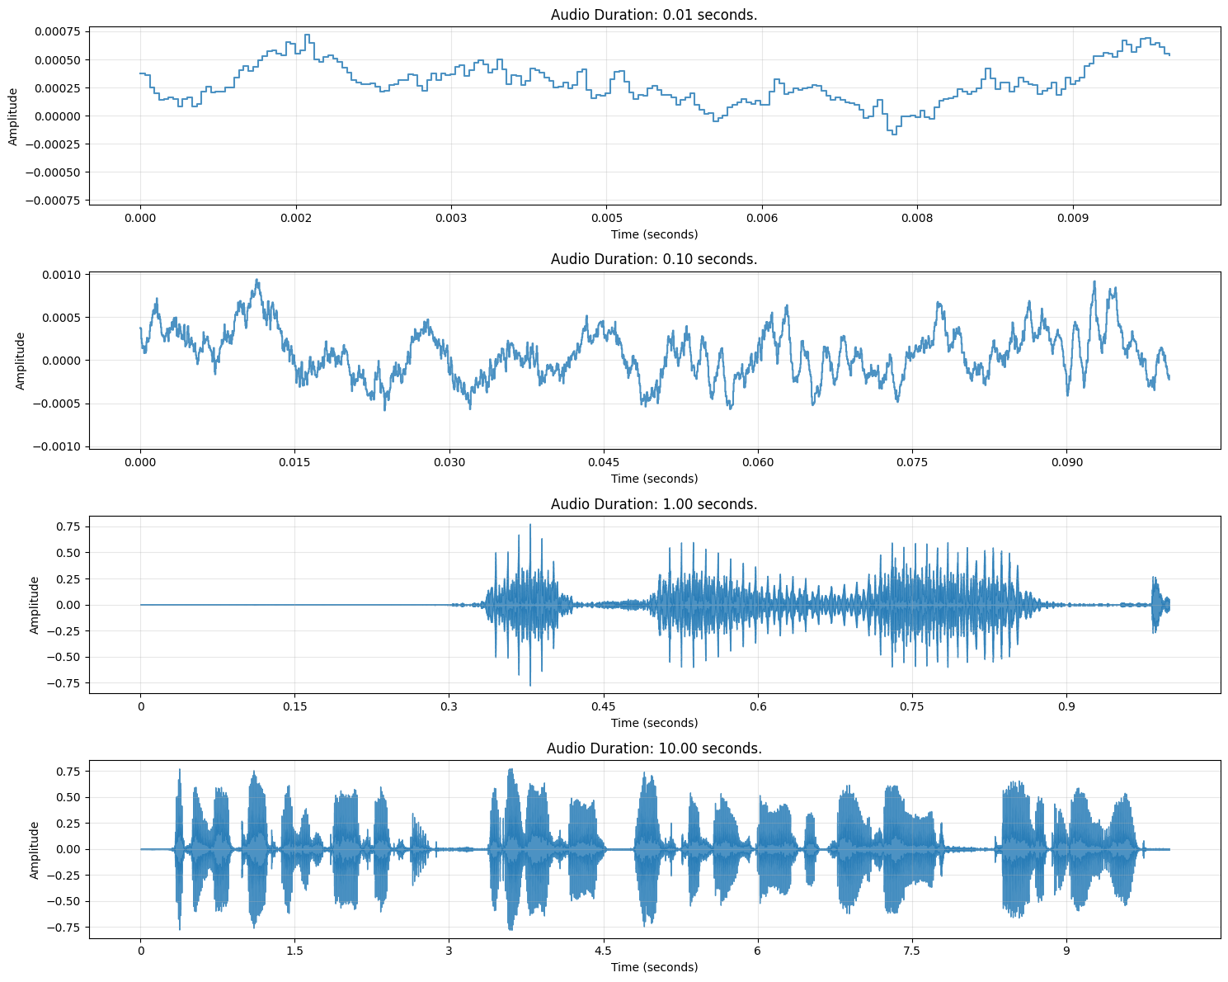
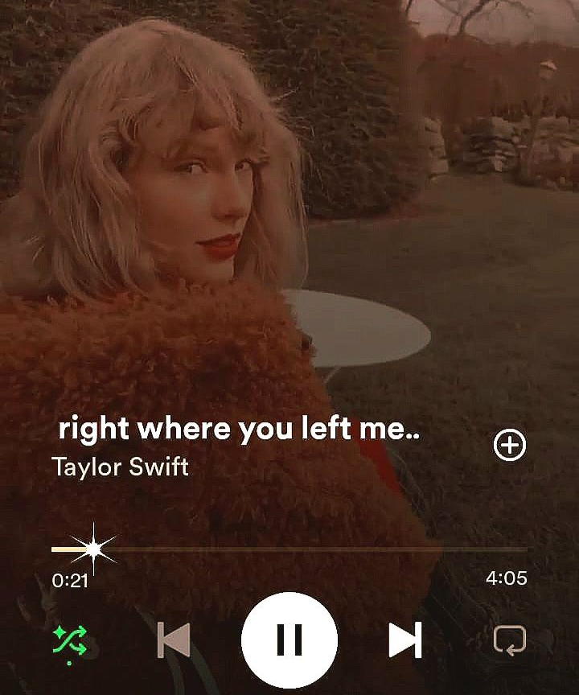
Why not use only waveforms?
High Dimensionality
Low Information Density
Full HD (1080p): 1920 × 1080 x 3 = 6220800 = 6M
Song: 4.05 minutes = 245 secs = 245 * 16 kHz * 2 channels = 7680000 = 7.6M

Slide 7
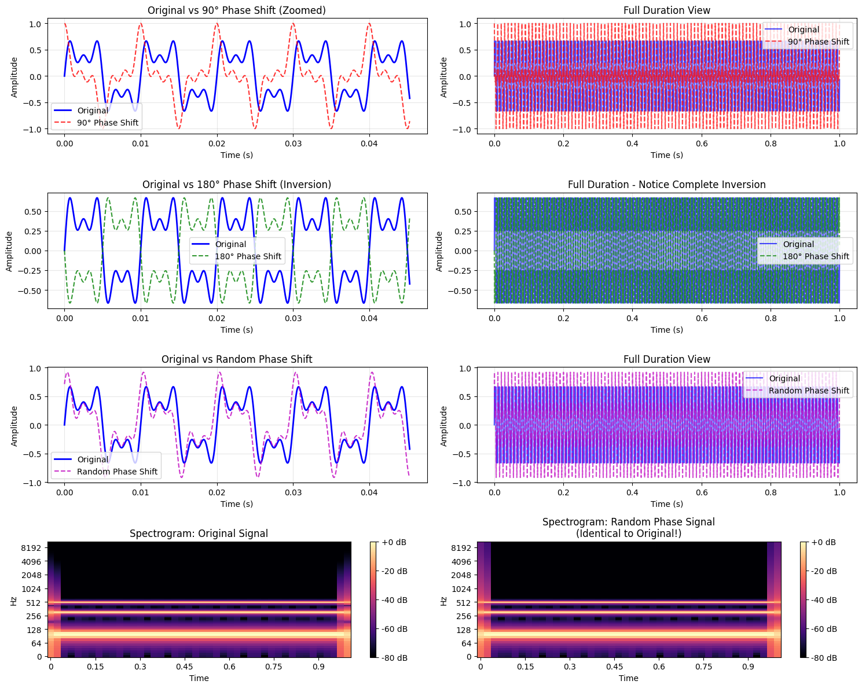
Why not use only waveforms?
Phase Sensitivity
For model original and shifted audio signal will be considered as totally different signals.

Slide 8
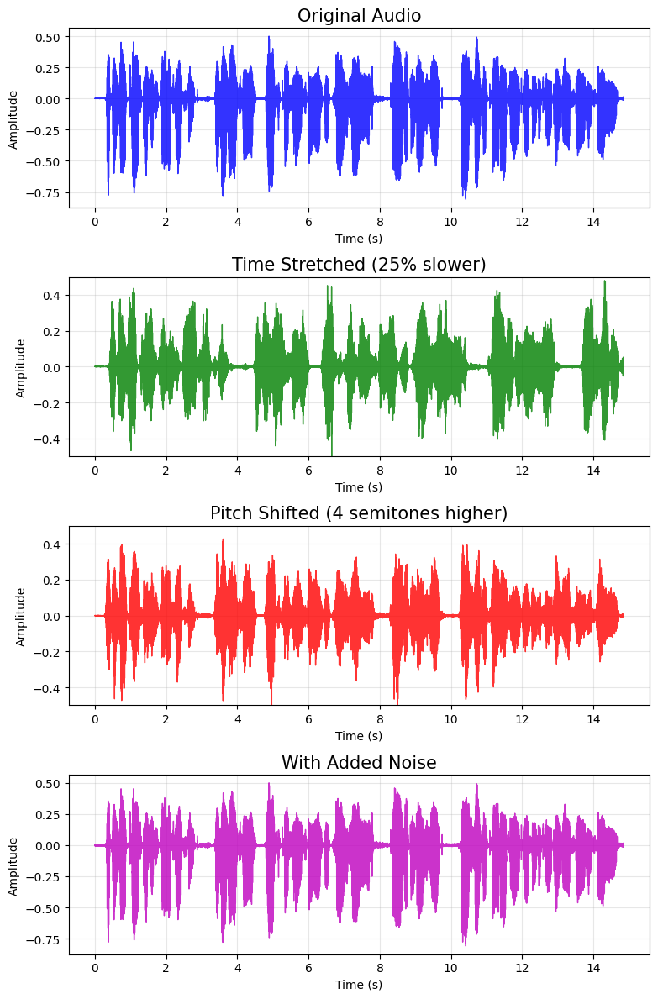

Why not use only waveforms?
Time Stretch,
Pitch Shift,
Noise
Looks almost the same!
We need another compact and informative representation!
Spoiler: spectrograms!

Slide 9
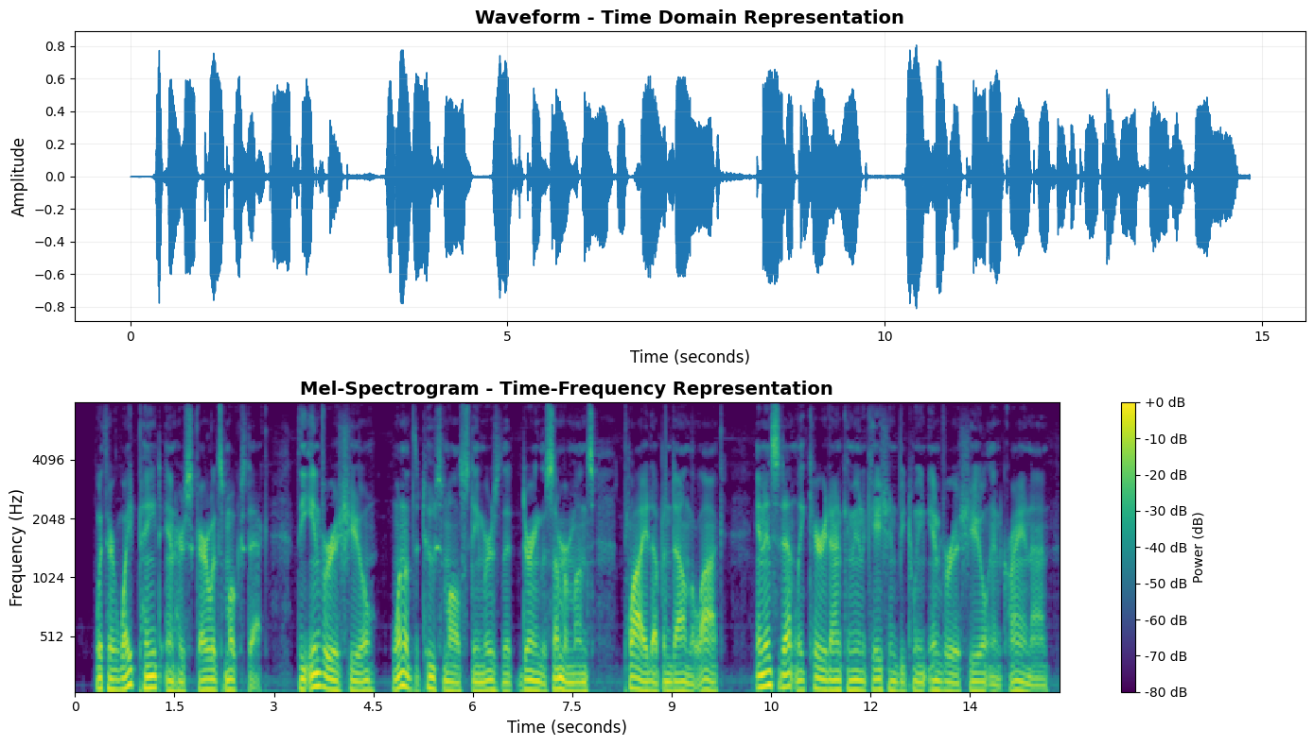
New representation: Spectrograms
Spectrograms!

Slide 10
Why spectrograms?
Phase Sensitivity
Spectrograms are the same!

Slide 11
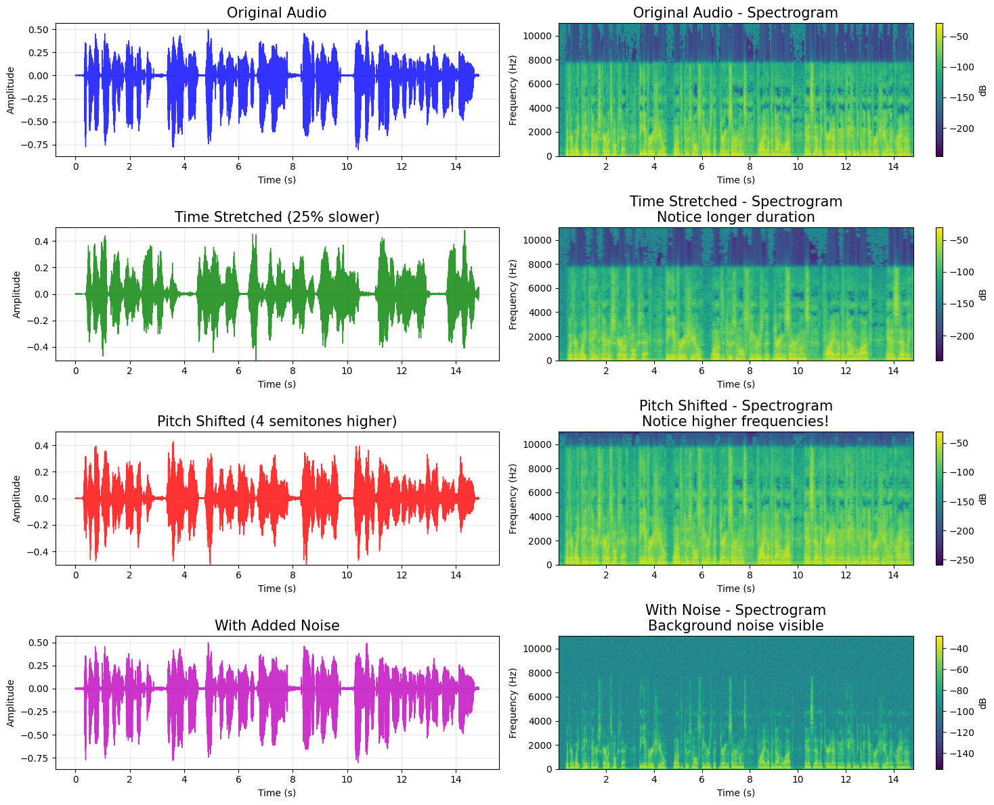
New representation: Spectrograms
Time Stretch,
Pitch Shift,
Noise
Spectrograms are different!

Slide 12
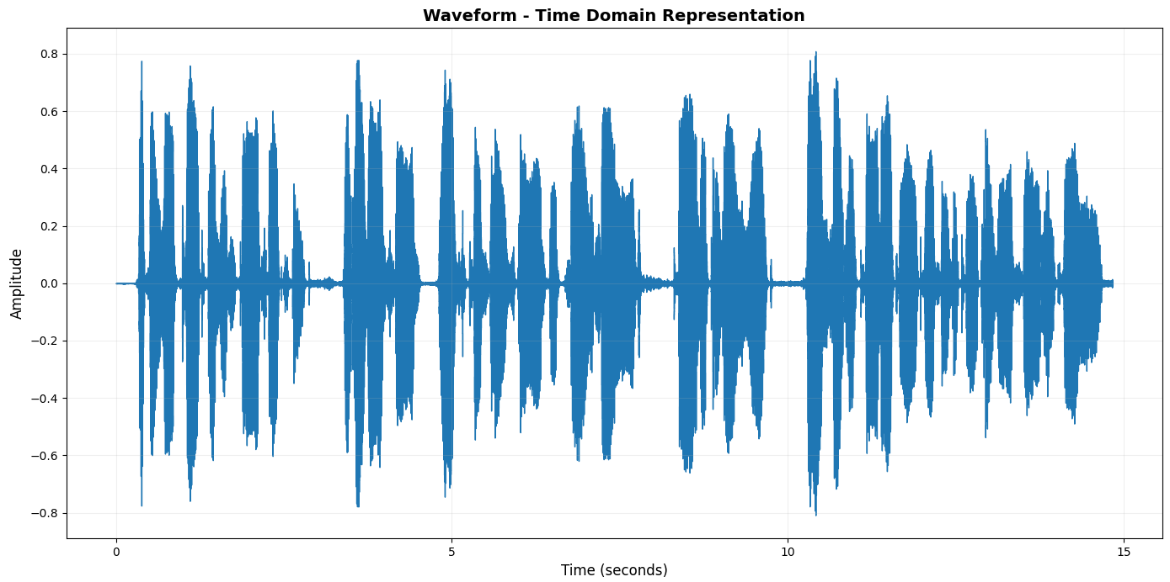
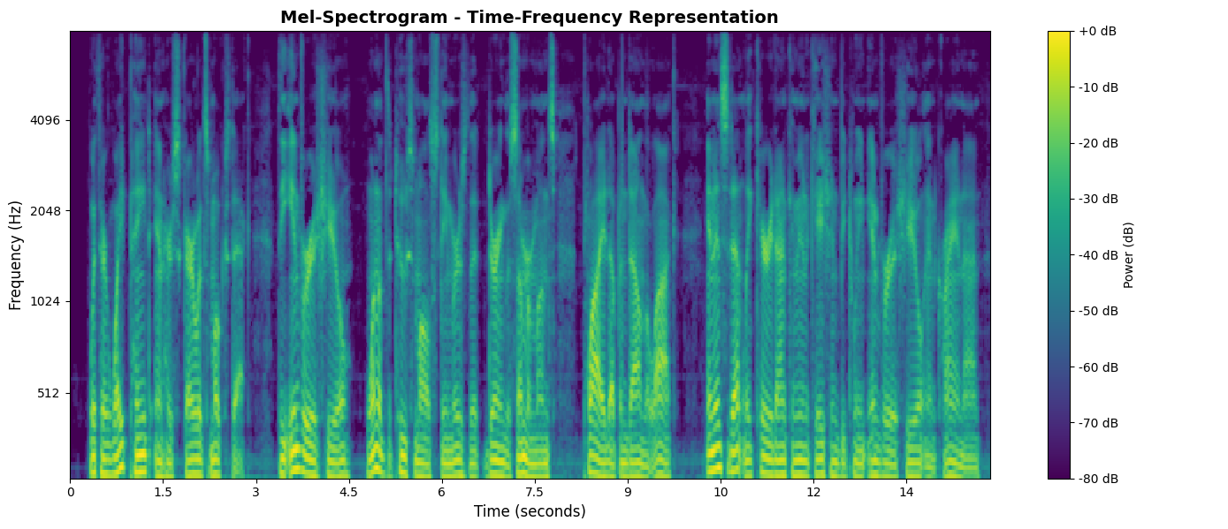
New representation: Spectrograms
Waveform
Mel-Spectrogram
Size: 327222 → 327K
Low Information density
Sensitive to phase shift
Not sensitive to time stretch, pitch shift, noise addition
Size: 81920 → 81K
High Information density
Not sensitive to phase shift
Sensitive to time stretch, pitch shift, noise addition

Slide 13
Fourier Series

Slide 14
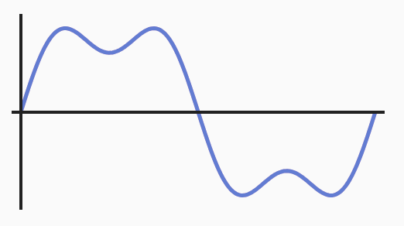
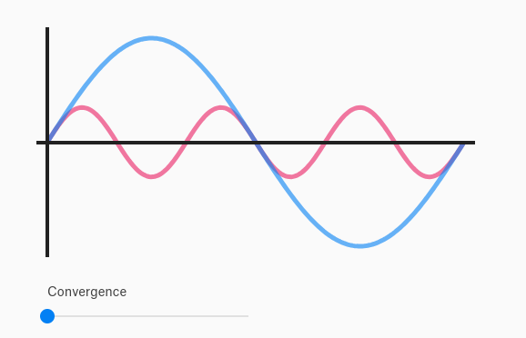
Signal as Fourier Series
Complex signal
Sum of simple signals
Any complex signal can be expand into simple signals!
Images source:https://pudding.cool/2018/02/waveforms/

Slide 15
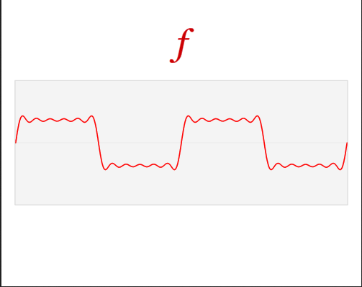
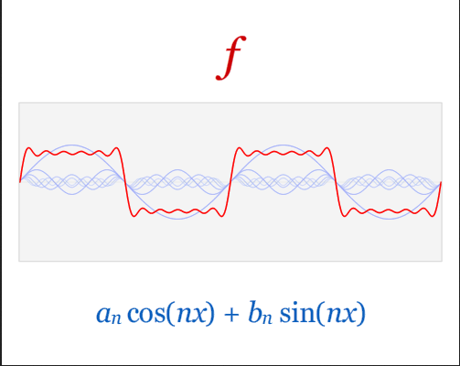
Signal as Fourier Series
Specifically: Any periodic function can be decomposed into a sum of sine and cosine waves.
Images from the source: Link to the source

Slide 16
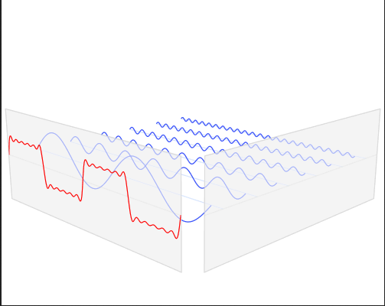
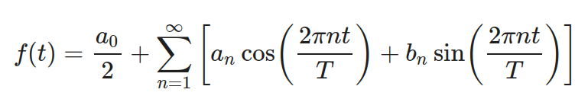
Signal as Fourier Series
More Specific: Any periodic function f(t) with period T and integrable over the interval [0, T], can be represented as a Fourier Series.
(t)
Fourier Series
Images from the source: Link to the source

Slide 17
Signal as Fourier Series
More Specific: Any periodic function f(t) with period T and integrable over the interval [0, T], can be represented as a Fourier Series:
The harmonic number.
n=1 is the fundamental frequency (the main pitch).
n=2 is the second harmonic (one octave higher).
n=3 is the third harmonic, and so on.
Images from the source: Link to the source

Slide 18
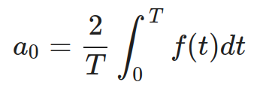
Signal as Fourier Series
More Specific: Any periodic function f(t) with period T and integrable over the interval [0, T], can be represented as a Fourier Series:
Просто среднее значение амплитуды за период T.
Images from the source: Link to the source

Slide 19
Signal as Fourier Series
More Specific: Any periodic function f(t) with period T and integrable over the interval [0, T], can be represented as a Fourier Series:
They are Fourier Coefficients.
Images from the source: Link to the source

Slide 20
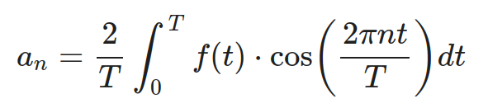
Signal as Fourier Series
More Specific: Any periodic function f(t) with period T and integrable over the interval [0, T], can be represented as a Fourier Series:
Показывает насколько сигнал похож на cosine wave при частоте n-гармоники.
If f(t) is an odd function (antisymmetric, like sin(t)), all aₙ (including a₀) will be zero.
Images from the source: Link to the source

Slide 21
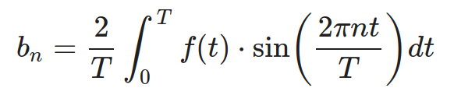
Signal as Fourier Series
More Specific: Any periodic function f(t) with period T and integrable over the interval [0, T], can be represented as a Fourier Series:
Показывает насколько сигнал похож на sine wave при частоте n-гармоники.
If f(t) is an even function (symmetric around the y-axis, like cos(t)), all bₙ will be zero.
Images from the source: Link to the source

Slide 22
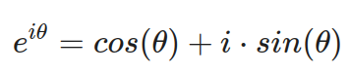
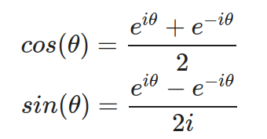
Signal as Fourier Series
More Specific: Any periodic function f(t) with period T and integrable over the interval [0, T], can be represented as a Fourier Series:
Instead of tracking two sets of real coefficients (aₙ and bₙ), we can track one set of complex coefficients (cₙ) by using Euler formula:
Images from the source: Link to the source

Slide 23
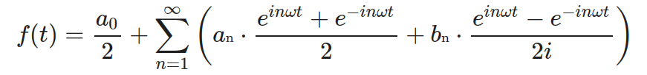
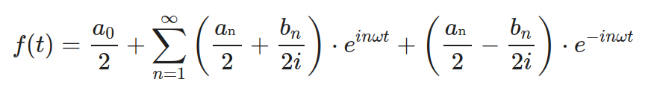
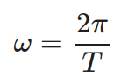
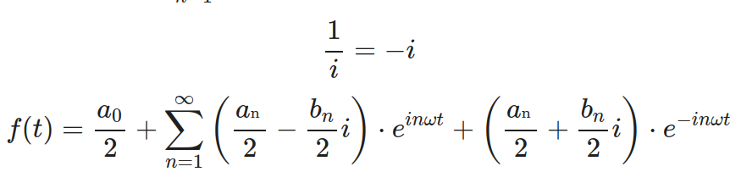
Signal as Fourier Series
Images from the source: Link to the source

Slide 24
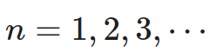
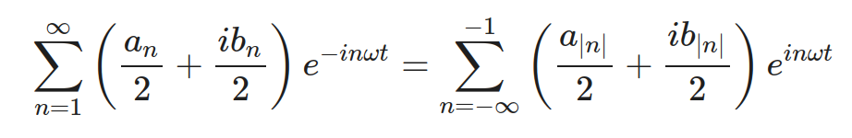
Signal as Fourier Series

Slide 25
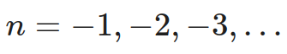
Signal as Fourier Series

Slide 26
Signal as Fourier Series

Slide 27
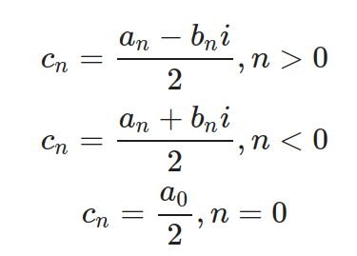
Signal as Fourier Series

Slide 28
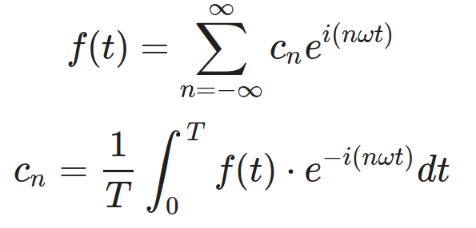
Signal as Fourier Series

Slide 29
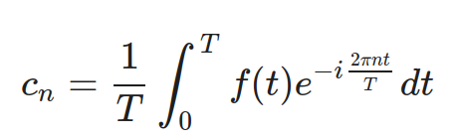
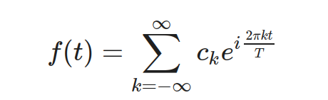
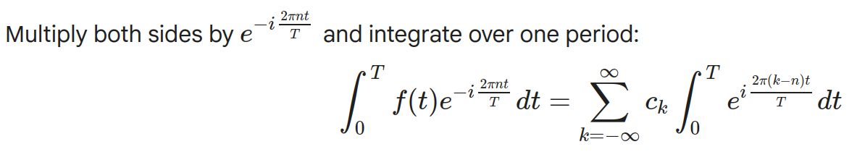
Signal as Fourier Series
Second thing we should prove is:
Let’s start with:

Slide 30
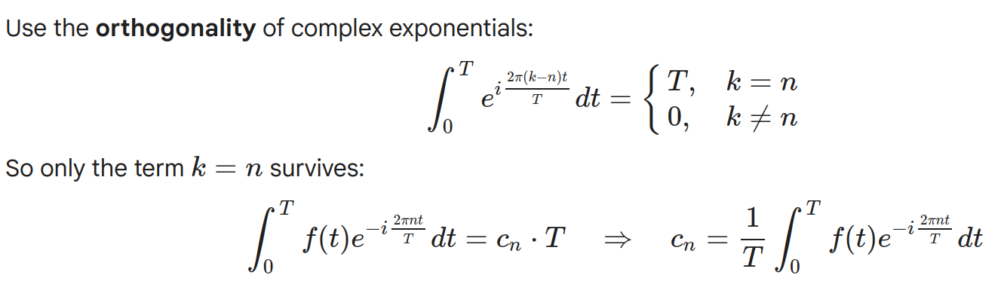
Signal as Fourier Series

Slide 31
Signal as Fourier Series

Slide 32
Signal as Fourier Series
More Specific: Any periodic function f(t) with period T and integrable over the interval [0, T], can be represented as a Fourier Series:
Instead of tracking two sets of real coefficients (aₙ and bₙ), we can track one set of complex coefficients (cₙ) by using Euler formula:
Images from the source: Link to the source

Slide 33
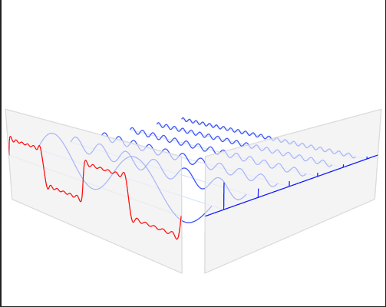
Signal as Fourier Series
Here frequency equals 1 Hz.
1 Hz
Images from the source: Link to the source

Slide 34
Signal as Fourier Series
Here frequency equals 3 Hz.
3 Hz
1 Hz
Images from the source: Link to the source

Slide 35
Signal as Fourier Series
Here frequency equals 5 Hz.
5 Hz
3 Hz
1 Hz
Images from the source: Link to the source

Slide 36
Signal as Fourier Series
5 Hz
3 Hz
Time
1 Hz
Images from the source: Link to the source

Slide 37
Signal as Fourier Series
Frequency
5 Hz
3 Hz
Time
1 Hz
Images from the source: Link to the source

Slide 38
Signal as Fourier Series
Amplitude
Frequency
5 Hz
3 Hz
Time
1 Hz
Images from the source: Link to the source

Slide 39
Signal as Fourier Series
Amplitude
Frequency
5 Hz
3 Hz
Time
1 Hz
But what is this axis?
Images from the source: Link to the source

Slide 40
Signal as Fourier Series
Amplitude
Frequency
5 Hz
3 Hz
Time
1 Hz
Magnitude
Higher magnitude indicates higher similarity between signal and sinusoid.
Images from the source: Link to the source

Slide 41
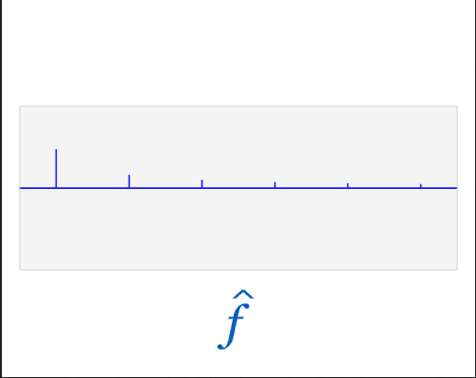
Signal as Fourier Series
We are interested in this frequency domain.
Amplitude
Frequency
5 Hz
3 Hz
Time
1 Hz
It is called Frequency Spectrum.
Limitation of Fourier Series: periodic signal and discrete frequency spectrum.
Images from the source: Link to the source

Slide 42
Signal as Fourier Series
We are interested in this frequency domain.
Amplitude
Magnitude
Time
Frequency
How can we get it for non-periodic signals?
Images from the source: Link to the source

Slide 43
Fourier Transform → Fourier Series for non-periodic signals.

Slide 44
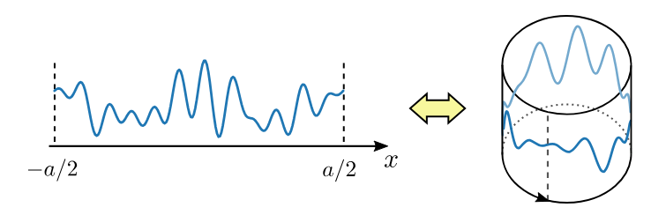
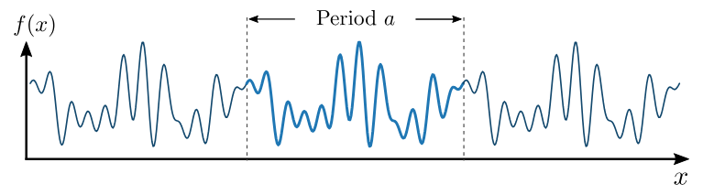
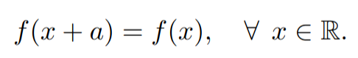
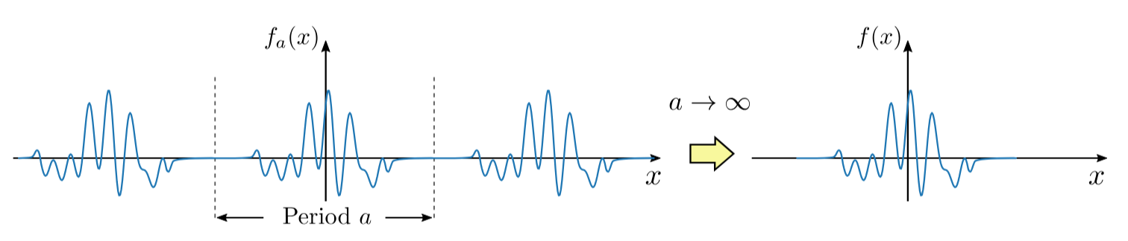
Fourier Transform
Let’s set periodicity a → ∞
Source:https://www1.spms.ntu.edu.sg/~ydchong/teaching/10_fourier_transform.pdf

Slide 45
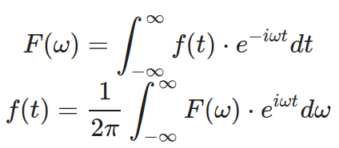
Fourier Transform
Let’s set periodicity a → ∞
Source:https://www1.spms.ntu.edu.sg/~ydchong/teaching/10_fourier_transform.pdf

Slide 46
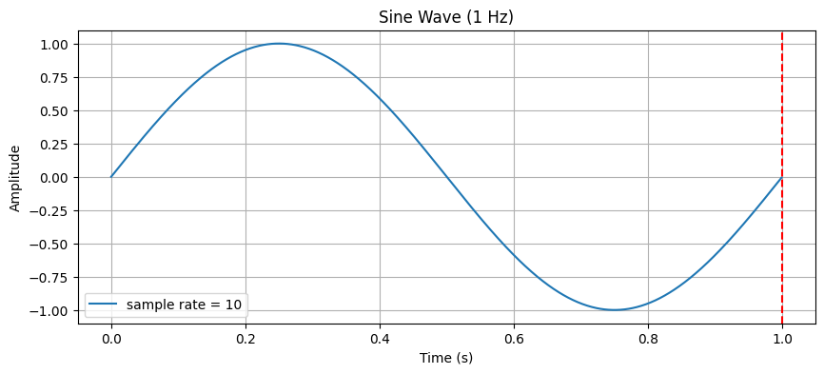
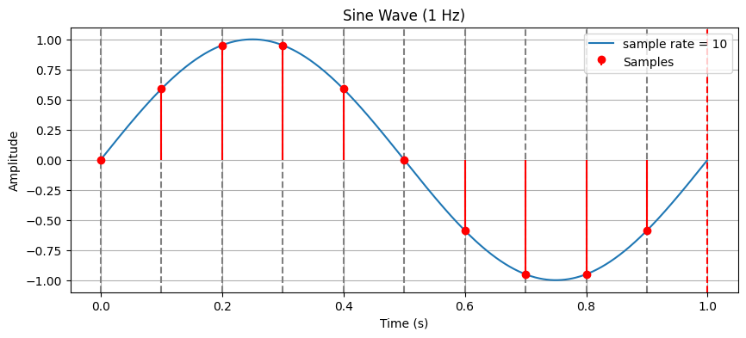
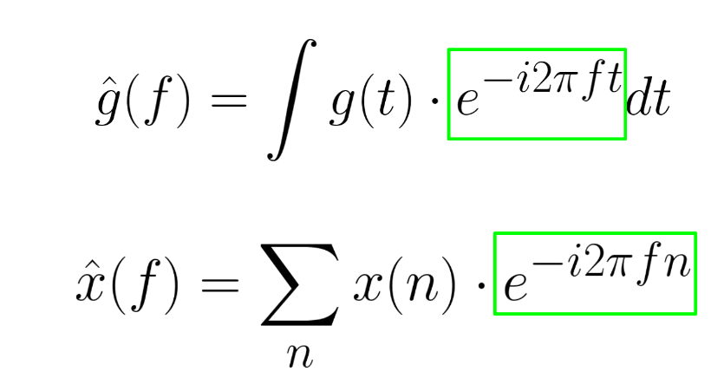
Discrete Fourier Transform
g(t)
t = nT
x[n]

Slide 47
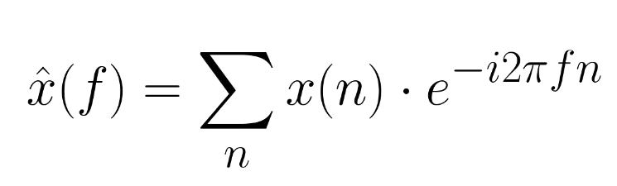
Discrete Fourier Transform
continuous

Slide 48
Discrete Fourier Transform
infinite

Slide 49
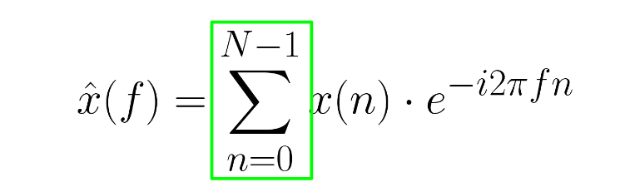
Discrete Fourier Transform
Let’s make finite number of samples [0, …, N-1]

Slide 50
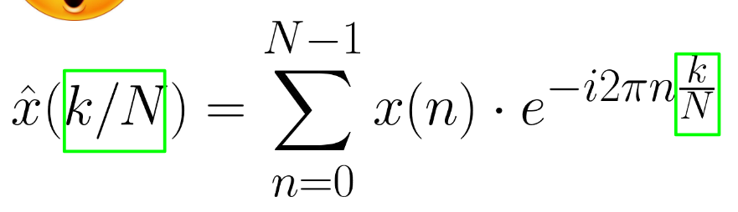
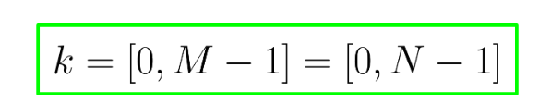
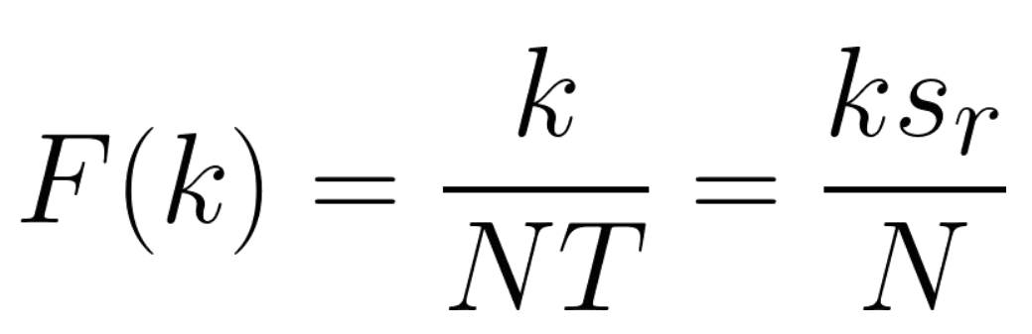
Discrete Fourier Transform
Let’s make finite number of samples [0, …, N-1]
2. Let’s make finite number of frequencies and M = N
To make the representation fully discrete, we sample x​(f) at N equally spaced frequencies over one period.

Slide 51
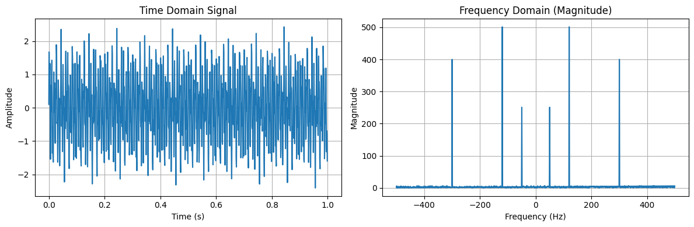
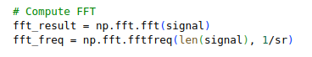
How to Extract the Fourier Transform with Python

Slide 52
How to Extract the Fourier Transform with Python
Same
Since they are symmetric…

Slide 53
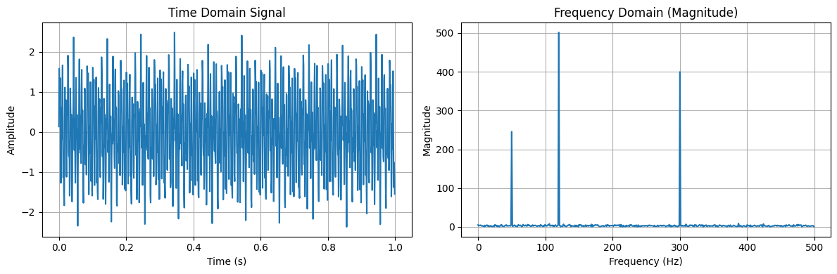
How to Extract the Fourier Transform with Python
People plot and use just half of it.

Slide 54
Short Time Fourier Transform (Spectrograms)

Slide 55

Catch changes of the spectrum over time: Short Time Fourier Transform (STFT)
But our signal changes over time.

Slide 56

STFT: window function
Let’s consider simple signal.

Slide 57


STFT: window function
Step 1. Apply window function to a signal

Slide 58
STFT: window function
Step 1. Apply window function to a signal

Slide 59

STFT: Different type of windows
There are lots of different window functions.

Slide 60
STFT: window function
Why rectangular window is just not enough?
This will be in your HW2.

Slide 61


STFT: window function
Important parameters:
Window Function

Slide 62
STFT: window function
Important parameters:
Window Function
Window Length
window length

Slide 63


STFT: window function
Important parameters:
Window function
Window Length
HOP Length
hop length

Slide 64

STFT: Discrete Fourier Transform
Important parameters:
Window function
Window Length
HOP Length
n_fft
window length
Step 2.
Each windowed segment (e.g., window length = 256 samples) is then transformed into the frequency domain using the DFT.
n_fft specifies the length of the DFT, i.e., how many frequency bins you want in the output.
DFT

Slide 65
STFT: Discrete Fourier Transform
The frequency axis goes from 0 Hz to the Nyquist frequency.
f_max = sample_rate / 2
Here: sample_rate = 1000 → f_max = 500 Hz

Slide 66
STFT: Discrete Fourier Transform
n_fft controls how many frequency bins are computed per time frame,
i.e. how many points between 0 Hz and f_max Hz.
frequencies = np.linspace(0, sample_rate / 2, n_fft // 2 + 1)

Slide 67
STFT: Discrete Fourier Transform
n_fft controls how many frequency bins are computed per time frame,
i.e. how many points between 0 Hz and f_max Hz.
frequencies = np.linspace(0, sample_rate / 2, n_fft // 2 + 1)
due to symmetry, return just half of it.

Slide 68
STFT: Discrete Fourier Transform
sample_rate = 1000
n_fft = 1024
frequency values diapason:
[o Hz, sr/2] → [0 Hz, 500 Hz]
frequency.shape:
[n_fft//2+1,1] → [513,1]
n_fft controls how many frequency bins are computed per time frame,
i.e. how many points between 0 Hz and f_max Hz.
frequencies = np.linspace(0, sample_rate / 2, n_fft // 2 + 1)
due to symmetry, return just half of it.

Slide 69

STFT: Discrete Fourier Transform
win_length = 200
sample_rate = 1000
n_fft = 1024
(200, 1)
Zero-padding:
If your window length (win_length) is less than n_fft, the windowed segment is zero-padded to length n_fft before applying the DFT.
Example: win_length = 256, n_fft = 512 → each 256-sample window is padded with 256 zeros before the DFT.
This increases frequency resolution in the display (more bins), but does not add real information—it just interpolates the spectrum.
DFT
(513,1)

Slide 70
STFT: Discrete Fourier Transform
win_length = 200
sample_rate = 1000
n_fft = 1024
(200, 1)
Summary:
n_fft controls how many frequency bins are computed per time frame. It can be larger than the actual window length (via zero-padding), which interpolates the spectrum but doesn’t increase true frequency resolution. True resolution depends on the window duration, not n_fft.
DFT
(513,1)

Slide 71


STFT: Discrete Fourier Transform
window length
DFT

Slide 72

STFT: Discrete Fourier Transform

Slide 73

STFT: Discrete Fourier Transform
Important parameters:
Window function
Window Length
HOP Length
n_fft
window length
view from the top
DFT

Slide 74
STFT: Discrete Fourier Transform
They are the same!

Slide 75
STFT: Discrete Fourier Transform
They are different!
Magnitude is normalized and rescaled implicitly in stft().

Slide 76

STFT: Discrete Fourier Transform
Here time is in seconds. But usually it remains in time frames.

Slide 77
Short Time Fourier Transform (STFT)
Summary:
Step 1. the input signal is divided into short, overlapping segments (windows).
Step 2. Each windowed segment (e.g., 256 samples) is then transformed into the frequency domain using the DFT.
Step 3. Plot all DFT frames all together into one spectral matrix.
Spectral matrix shape: [frequency_bins, frames]
frequency_bins = n_fft // 2 + 1
frames = (n_samples - win_length)/ hop_length
Default in librosa:
hop_length = win_length // 4
win_length = n_fft

Slide 78



STFT with Librosa
Here is a real speech.
STFT

Slide 79

STFT with Torchaudio
Here is a real speech.
STFT

Slide 80

STFT: Magnitude and Phase
The output of STFT is a complex matrix. Usually we do not use phase values and just look at the magnitude.

Slide 81
Mel-Spectrograms

Slide 82


Human Perception: Mel-scale
We created this Mel-scale doing psychological experiments with human perception.
Empirical formula:
“Mel” is from the word “melody”, because melody is connected with the concept of pitch.

Slide 83



How to create Mel-Spectrograms from Spectrogram
Frequency
Let’s consider simple example:
Hz
0
500
Notes:
Обычно берётся минимальная частота (например 300 Гц) и максимальная частота (например, 4000 Гц)
Не имеет смысла брать верхнюю границу выше, чем Sample rate / 2

Slide 84
How to create Mel-Spectrograms from Spectrogram
Frequency
Let’s consider simple example:
Hz
0
500
Mel
0
607.4
Notes:
Обычно берётся минимальная частота (например 300 Гц) и максимальная частота (например, 4000 Гц)
Не имеет смысла брать верхнюю границу выше, чем Sample rate / 2

Slide 85

What is a Mel Bands?
Frequency
Let’s consider simple example:
Hz
0
500
Mel
0
607.4
Let’s set:
Notes:
Обычно берётся минимальная частота (например 300 Гц) и максимальная частота (например, 4000 Гц)
Не имеет смысла брать верхнюю границу выше, чем Sample rate / 2

Slide 86
What is a Mel Bands?
Frequency
Let’s consider simple example:
Hz
0
500
Mel
0
607.4
evenly spaced
Let’s set:
how many points between f_min and f_max we will set
Mel
0
607.4
Notes:
Обычно берётся минимальная частота (например 300 Гц) и максимальная частота (например, 4000 Гц)
Не имеет смысла брать верхнюю границу выше, чем Sample rate / 2

Slide 87
What is a Mel Bands?
Frequency
Let’s consider simple example:
Hz
0
500
Mel
0
607.4
evenly spaced
Let’s set:
how many points between f_min and f_max we will set
Mel
0
607.4
0
202.4
401.9
607.4
Notes:
Обычно берётся минимальная частота (например 300 Гц) и максимальная частота (например, 4000 Гц)
Не имеет смысла брать верхнюю границу выше, чем Sample rate / 2

Slide 88
What is a Mel Bands?
Let’s consider simple example:
0
202.4
401.9
607.4
Mel
0
137.7
302.6
500
Hz
Let’s set:
how many points between f_min and f_max we will set
Notes:
Обычно берётся минимальная частота (например 300 Гц) и максимальная частота (например, 4000 Гц)
Не имеет смысла брать верхнюю границу выше, чем Sample rate / 2

Slide 89

Remainder what is a n_fft
Let’s consider simple example:
Frequency
Hz
0
500
Hz
0
500
Let’s set:
0
100
200
300
400
500
fft bins
0
1
2
3
4
5
fft bin indices
Notes:
Обычно берётся минимальная частота (например 300 Гц) и максимальная частота (например, 4000 Гц)
Не имеет смысла брать верхнюю границу выше, чем Sample rate / 2

Slide 90
How many Mel Bands?
Remainder what is a n_fft
Let’s consider simple example:
0
1
2
3
4
5
fft bin indices
0
100
200
300
400
500
fft bins
0
137.7
302.6
500
Hz
Let’s set:
Notes:
Обычно берётся минимальная частота (например 300 Гц) и максимальная частота (например, 4000 Гц)
Не имеет смысла брать верхнюю границу выше, чем Sample rate / 2

Slide 91
Remainder what is a n_fft
Let’s consider simple example:
0
1
2
3
4
5
fft bin indices
0
100
200
300
400
500
fft bins
0
137.7
302.6
500
Hz
0
1
3
5
bin indices
Let’s set:
Notes:
Обычно берётся минимальная частота (например 300 Гц) и максимальная частота (например, 4000 Гц)
Не имеет смысла брать верхнюю границу выше, чем Sample rate / 2

Slide 92

Mel-filterbanks
0
137.7
302.6
500
Hz
Let’s consider simple example:
0
1
3
5
bin indices
Let’s set:
Notes:
Обычно берётся минимальная частота (например 300 Гц) и максимальная частота (например, 4000 Гц)
Не имеет смысла брать верхнюю границу выше, чем Sample rate / 2

Slide 93

Mel-filterbanks
Let’s create a filter bank.
Notes:
Обычно берётся минимальная частота (например 300 Гц) и максимальная частота (например, 4000 Гц)
Не имеет смысла брать верхнюю границу выше, чем Sample rate / 2

Slide 94

Mel-filterbanks
Let’s create a filter bank.
Notes:
Обычно берётся минимальная частота (например 300 Гц) и максимальная частота (например, 4000 Гц)
Не имеет смысла брать верхнюю границу выше, чем Sample rate / 2

Slide 95
Mel-filterbanks
Let’s create a filter bank.
bin indices
0
1
3
5
Notes:
Обычно берётся минимальная частота (например 300 Гц) и максимальная частота (например, 4000 Гц)
Не имеет смысла брать верхнюю границу выше, чем Sample rate / 2

Slide 96
Mel-filterbanks
Let’s create a filter bank.
bin indices
0
1
3
5
0
fft bin indices
0
1
2
3
4
5
Notes:
Обычно берётся минимальная частота (например 300 Гц) и максимальная частота (например, 4000 Гц)
Не имеет смысла брать верхнюю границу выше, чем Sample rate / 2

Slide 97

Mel-filterbanks
Let’s create a filter bank.
bin indices
0
1
3
5
0
1
fft bin indices
0
1
2
3
4
5
Notes:
Обычно берётся минимальная частота (например 300 Гц) и максимальная частота (например, 4000 Гц)
Не имеет смысла брать верхнюю границу выше, чем Sample rate / 2

Slide 98

Mel-filterbanks
Let’s create a filter bank.
bin indices
0
1
3
5
0
1
0.5
fft bin indices
0
1
2
3
4
5
Notes:
Обычно берётся минимальная частота (например 300 Гц) и максимальная частота (например, 4000 Гц)
Не имеет смысла брать верхнюю границу выше, чем Sample rate / 2

Slide 99
Mel-filterbanks
Let’s create a filter bank.
bin indices
0
1
3
5
0
1
0.5
0
0
0
0
0
0.5
1
0.5
0
fft bin indices
0
1
2
3
4
5
Notes:
Обычно берётся минимальная частота (например 300 Гц) и максимальная частота (например, 4000 Гц)
Не имеет смысла брать верхнюю границу выше, чем Sample rate / 2

Slide 100
Mel-filterbanks
Spectrogram
Filter Bank
time frames
0
1
0.5
0
0
0
0
0
0.5
1
0.5
0
Notes:
Обычно берётся минимальная частота (например 300 Гц) и максимальная частота (например, 4000 Гц)
Не имеет смысла брать верхнюю границу выше, чем Sample rate / 2

Slide 101
Mel-filterbanks
Spectrogram
Filter Bank
Time frames
0
1
0.5
0
0
0
0
0
0.5
1
0.5
0
Notes:
Обычно берётся минимальная частота (например 300 Гц) и максимальная частота (например, 4000 Гц)
Не имеет смысла брать верхнюю границу выше, чем Sample rate / 2

Slide 102
Mel-filterbanks
Spectrogram
Time frames
Filter Bank
0
1
0.5
0
0
0
*
0
0
0.5
1
0.5
0
Notes:
Обычно берётся минимальная частота (например 300 Гц) и максимальная частота (например, 4000 Гц)
Не имеет смысла брать верхнюю границу выше, чем Sample rate / 2

Slide 103
Mel-filterbanks
Spectrogram
Mel-Spectrogram
Filter Bank
0
1
0.5
0
0
0
*
=
0
0
0.5
1
0.5
0
,
,
Time frames
,
Time frames

Slide 104
Mel-filterbanks
Optional:
Spectrogram
log(Mel-Spectrogram)
Filter Bank
0
1
0.5
0
0
0
*
=
0
0
0.5
1
0.5
0
,
,
Time frames
,
Time frames

Slide 105
Mel-filterbanks
Optional:
Spectrogram
Normalize(log(Mel-Spectrogram))
Filter Bank
0
1
0.5
0
0
0
*
=
0
0
0.5
1
0.5
0
,
,
Time frames
,
Time frames

Slide 106


How to plot mel-spectrograms in Librosa?

Slide 107


How to plot mel-spectrograms in Torchaudio?

Slide 108
Summary
Wav
Mel-Spectrogram
Waveform is not convenient, because they are high dimensional with low information density. Spectrograms give you more compact and informative representation.
From waveform to mel-spectrogram:
Any periodic function can be expand into a Fourier series, which are sinus and cosinus waves.
Fourier transform can calculate frequencies of all sinus waves which form our complex signal.
We use STFT to create dynamic spectrum, and this is how we get a spectrogram.
Then we scale it to the human preference with mel-scale and get Mel-Spectrogram.
Fourier Series
FT
STFT
Mel-Spectrogram
Mel-
scale

Slide 109
Спасибо
за внимание!
Если у вас остались вопросы, пишите в чат курса.
Yermekova Assel
Telegram: @zametki_polukrovki - тут я рассказываю какие то вещи.
2025

